Slide 1


FSC in Europe
Indrek Talpsep (FSC Estonia)
Jurmala, FSC Baltic meeting
08.03.2017
Notes:
Overall big picture about FSC in Europe. Start with some data and then move on to our realities, our focus areas, etc.

Slide 2
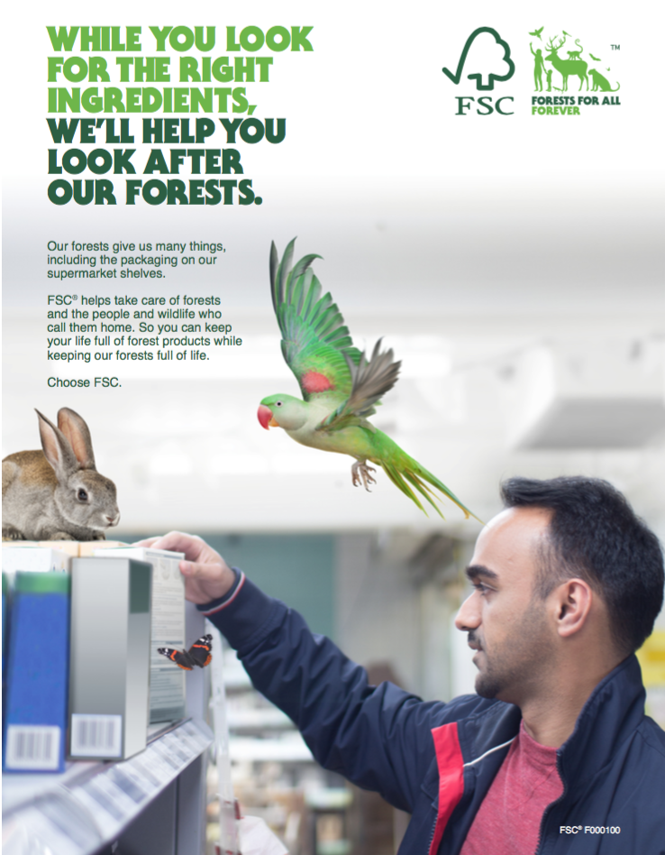
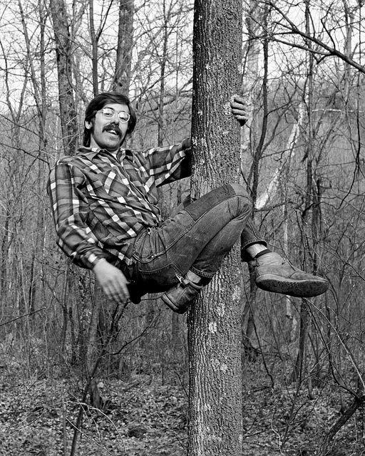
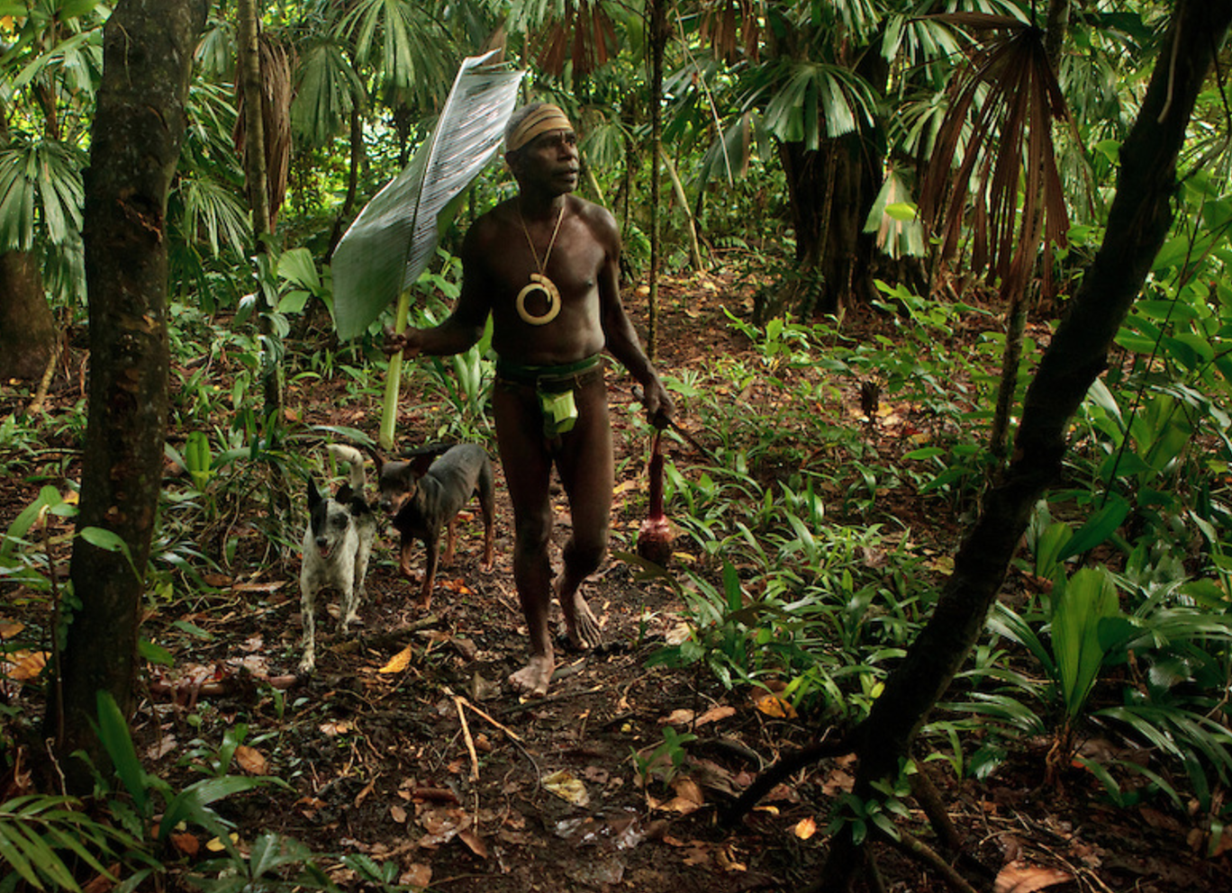

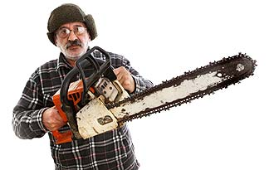
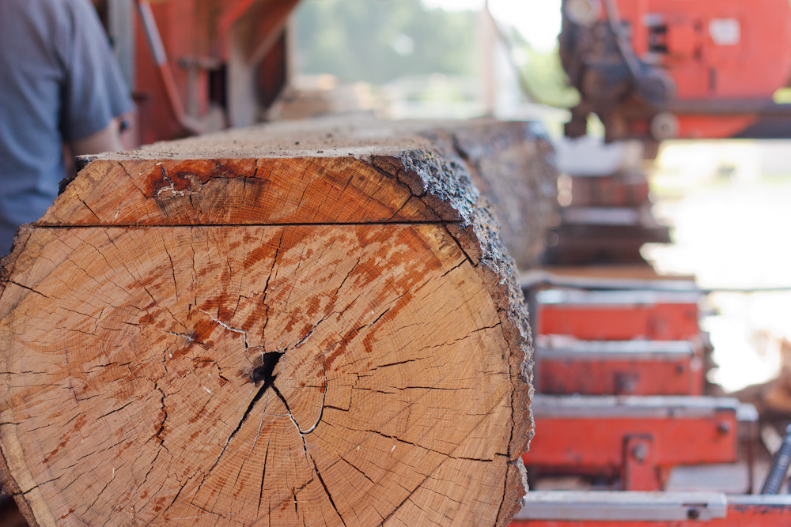
What is FSC?

Slide 3
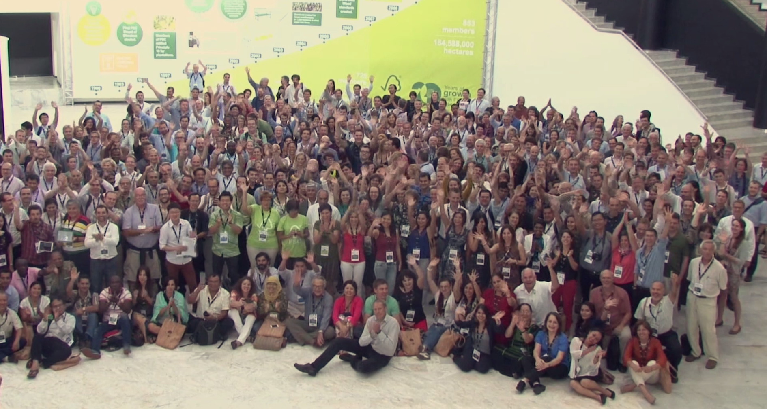
What is FSC?

Slide 4
FSC Governance

Slide 5

FSC FM standard setting
Follows formal procedures
3 chamber structure standard development group
Public consultations
Approval by FSC Policy and Standards Unit – Policy and Standards Committee (formal approval by FSC Director General)
Notes:
Setting a standard means following A BUNCH of standards

Slide 6

FSC FM standard content
Principles and Criteria – to be followed by everyone globally
Indicators allow national adaptation
International Generic Indicators
Certification Body standard(s) if no national standard

Slide 7
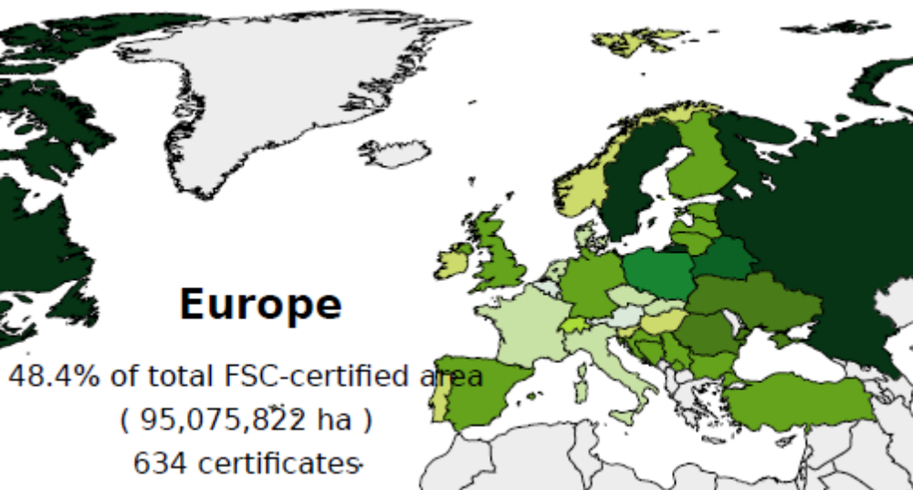
FSC Certified Area in Europe
Source: FSC Facts & Figures, January 2017
Notes:
Big increase in some countries (Finland +185% from 1,3 to 1,8 mio; Ukraine +33% from 1,9 to 2,6 mio); big decline in others (Latvia -26% from 1,7 to 1,3 mio)

Slide 8
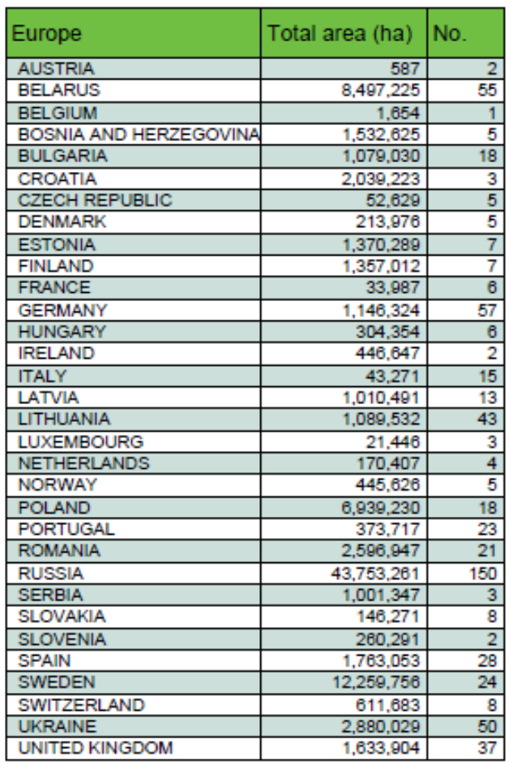
FSC Certified Area in Europe
Source: FSC Facts & Figures, January 2017

Slide 9
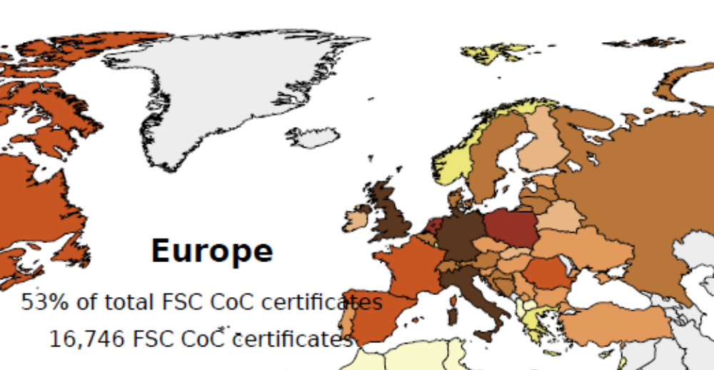
FSC CoC Certificates in Europe
Source: FSC Facts & Figures, January 2017

Slide 10
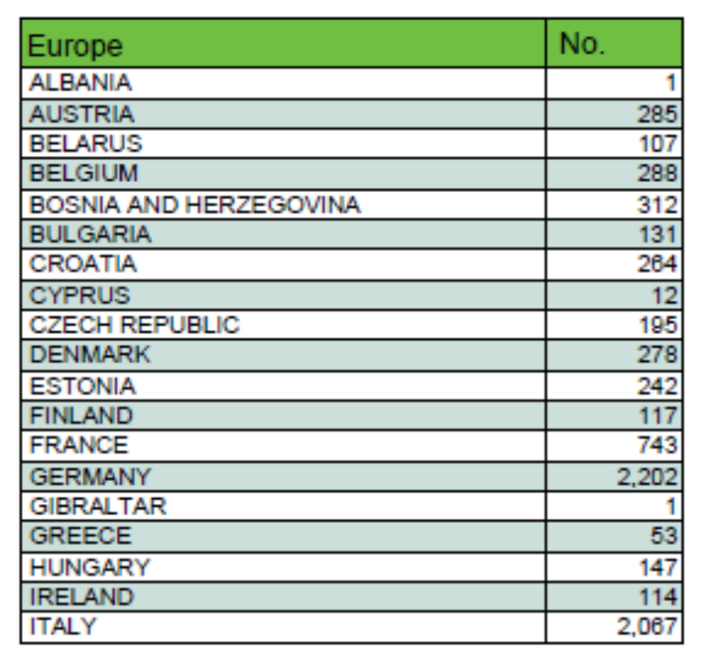
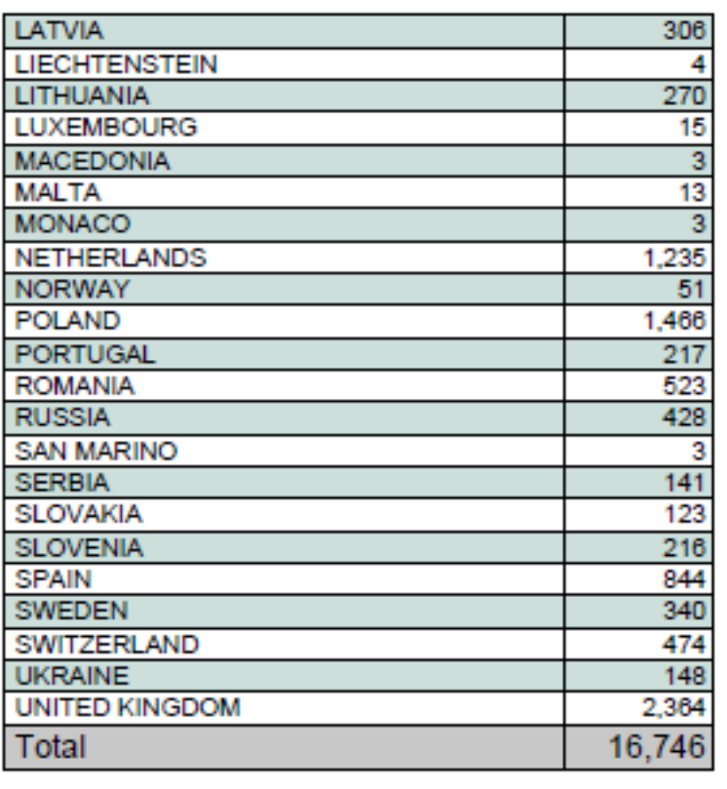
FSC CoC Certificates in Europe
Source: FSC Facts & Figures, January 2017
Notes:
ALL DATA IS CORRECT AS OF 4TH JAN 2017.

Slide 11
FSC membership

Slide 12
Awareness of FSC
 |  | unprompted | prompted
Europe | Switzerland |  | 85
Europe | Netherlands | 21 | 79
Europe | Denmark |  | 50
Europe | Germany | 9 | 50
Europe | Italy | 8 | 48
Europe | UK |  | 44
Europe | Spain |  | 40
Europe | Belgium | 8 | 38
Europe | France |  | 27
Europe | Czech Republic | 8 | 25
North America | United States | 8 | 21
Europe | Sweden | 18
CIS | Russia | 6 | 15
Europe | Estonia |  | 8
Europe | Latvia | 2 | 8

Slide 13
FSC’s Reality in Europe
Most mature region of FSC scheme
  Most staff / offices but smallest by geographic area = most diverse
  15 NO’s, 1 NR (LV), representation in PL and LI, actively looking for RO.
Critical sourcing region and main market for most key players
  Nearly half of FSC certified forests (91 mio ha) - 47%
  More than half of all FSC CoCs in Europe - 53%
  Top 10 countries for highest level of consumer awareness - all European
Certified forests dominated by public owned / state forests
  Growth most likely to come from private forests
27% of international members
  Many more national members than international (1005 vs 231)
  National vs International agendas
Perceived as a “low risk” sourcing region
  Pressure from CH’s to simplify FM, CoC and CW.
  Strong Environmental chamber challenging this perception
  Strong competition (PEFC)
Notes:
PEFC has same amount of certified 95M, 10% of that is double-cert

Slide 14

  Thank you!
Forest Stewardship Council®
FSC® Estonia
Lai 29, 51014, Tartu, Estonia
i.talpsep@ee.fsc.org
FSC® F000210 - FSC® A.C. All rights reserved
ee.fsc.org

